Slide 3


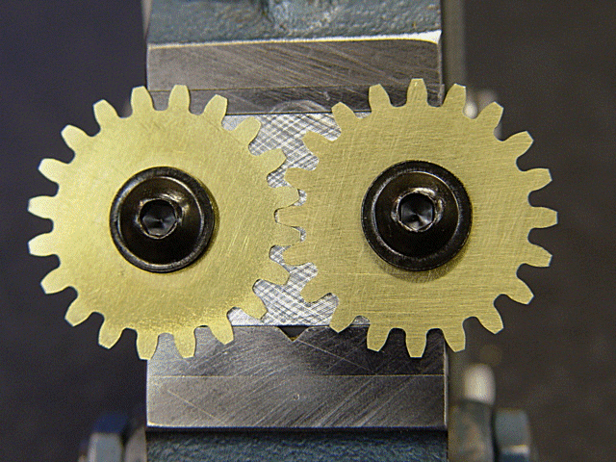
Making Heads or Tails out of a Machinery & Equipment Appraisal

Slide 4
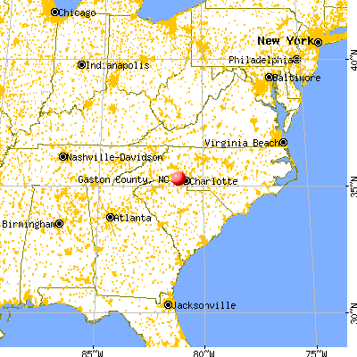
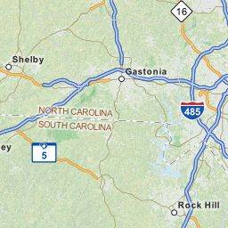
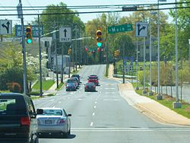
Location of Subject Appraisal:
Gastonia, North Carolina

Slide 5
Machinery & Equipment Appraisal Basics
USPAP Standard 7: Personal Property Appraisal, Development
USPAP Standard 8: Personal Property, Reporting
  Self contained
  Summary
  Restricted use

Slide 6
M&E Appraisers
No License required – Caveat Utilitor
Machinery & Equipment Designations
  PPS - International Association of Assessing Officers
  ASA, AM – American Society of Appraisers
  MCMEA, CMEA – NEBB Institute
  CEA/ AEA - Association of Machinery & Equipment Appraisers

Slide 7
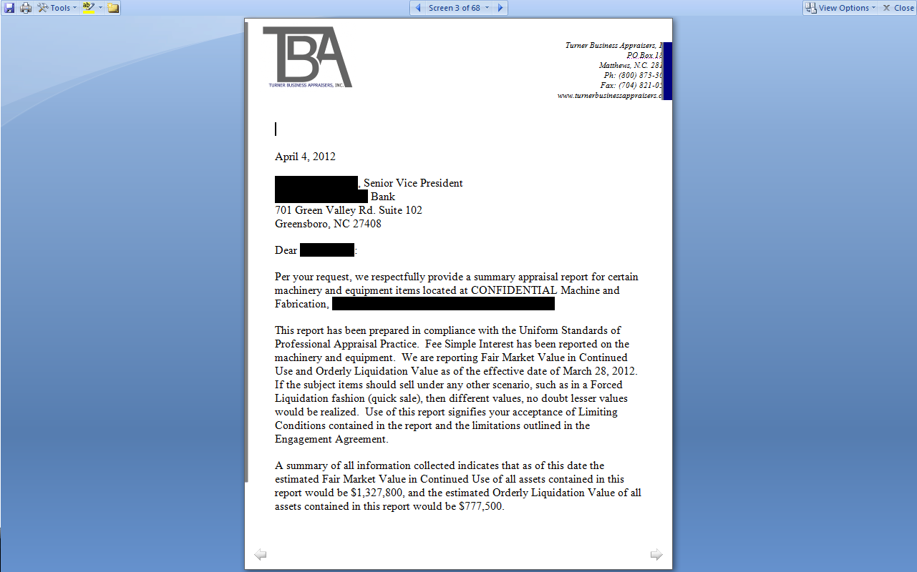
Letter of Transmittal

Slide 8
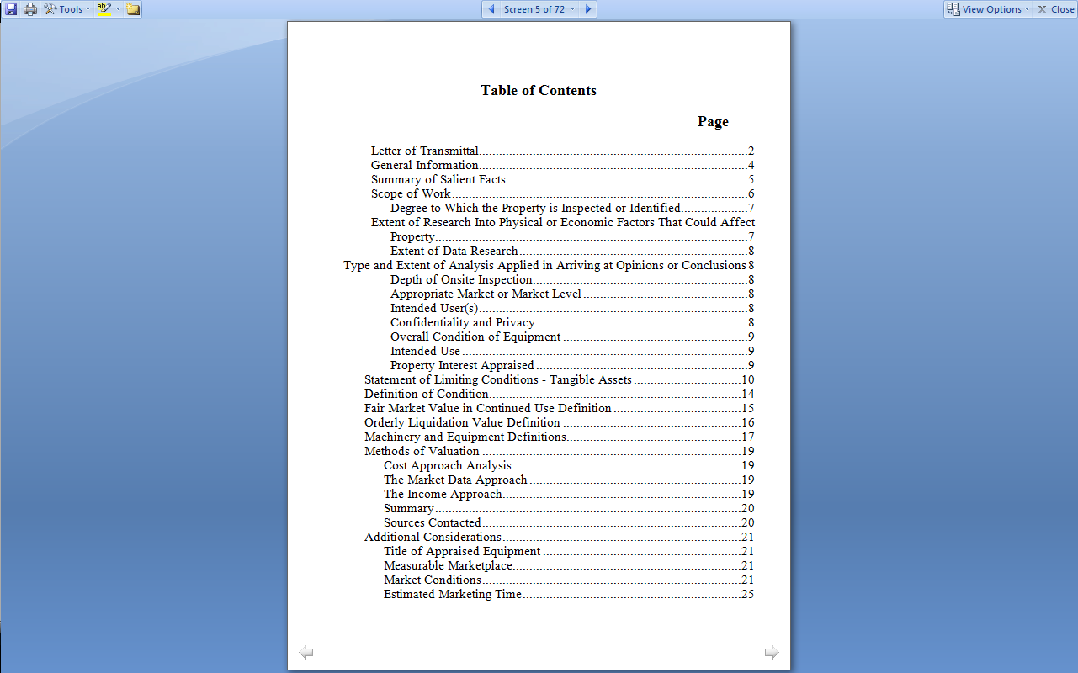
Appraisal Contents

Slide 9
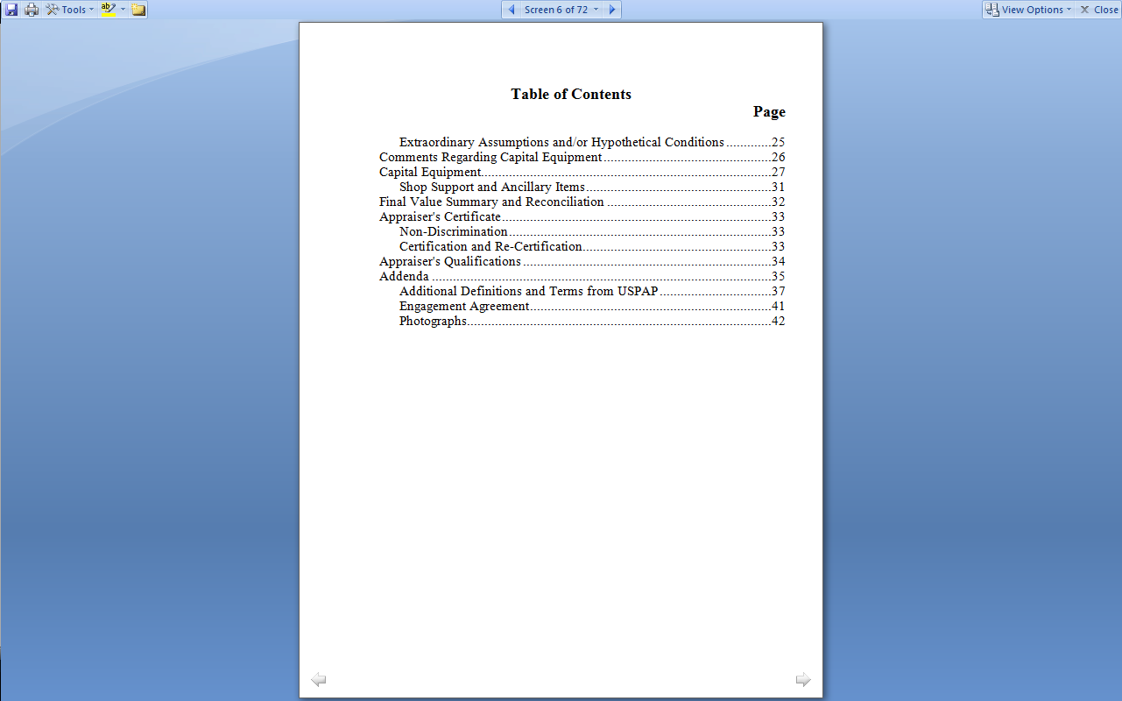
Appraisal Contents (Continued)

Slide 10
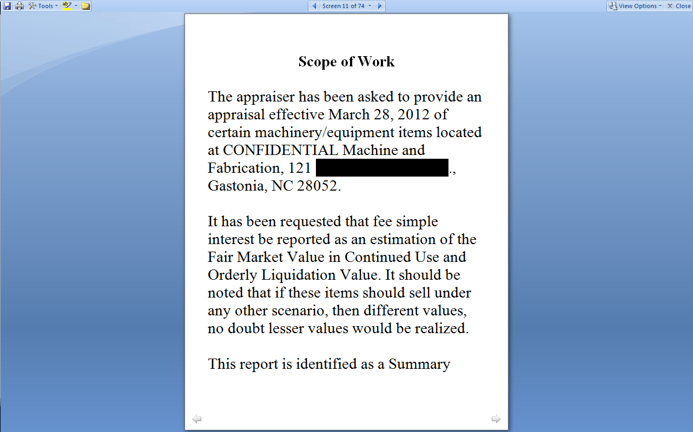
Scope of Work

Slide 11
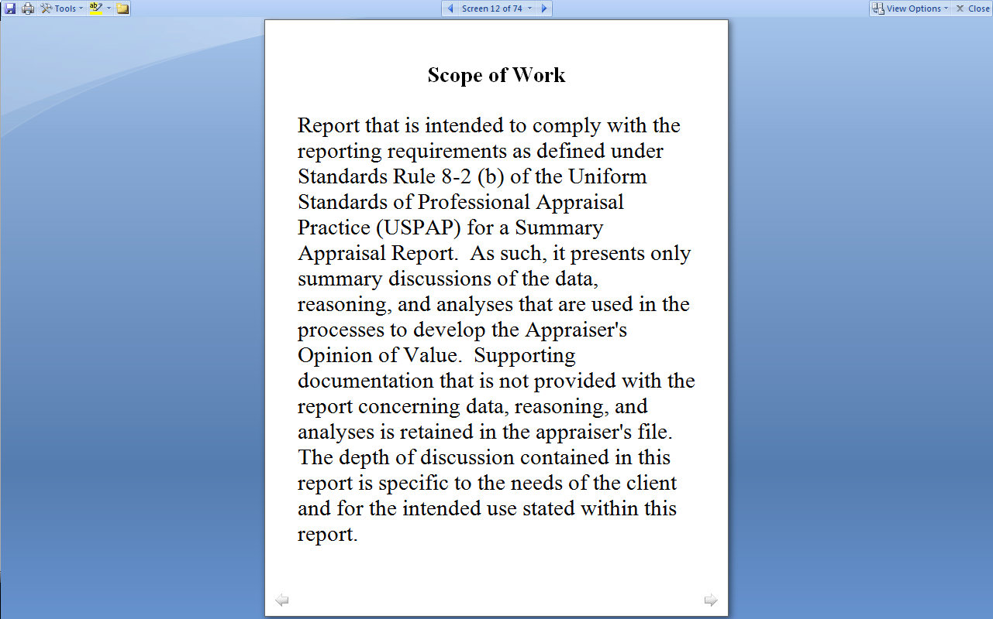
Scope of Work (Continued)

Slide 12
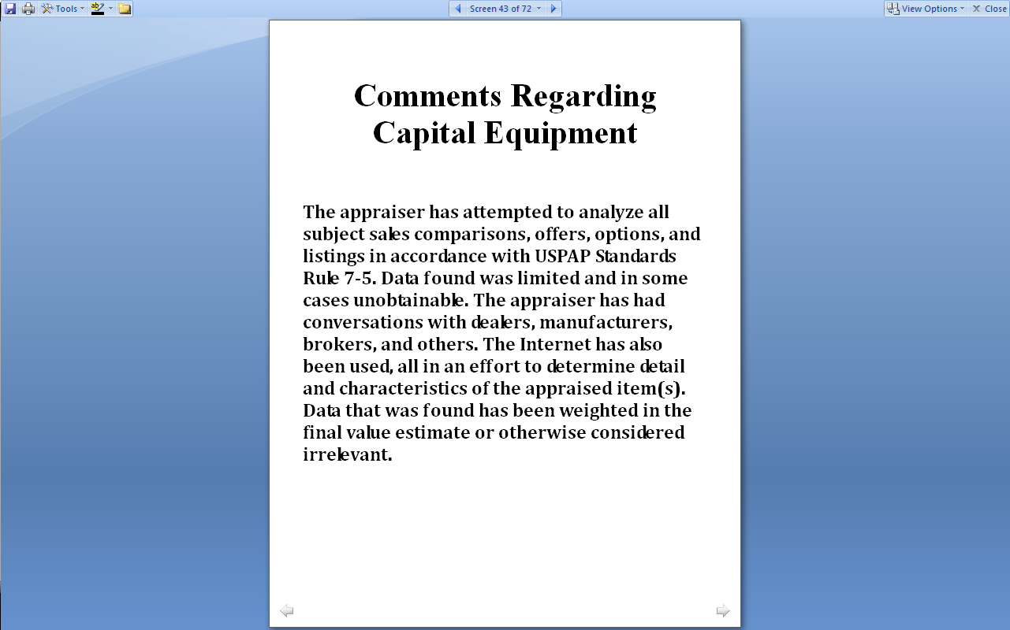
Caveat Utilitor

Slide 13
The Subject Machine Shop Equipment
  Turning is a machining process in which a cutting tool, typically a non-rotary tool bit, describes a helical toolpath by moving more or less linearly while the workpiece rotates.
  Forming- A CNC press brake uses programs to automatically execute a series of bending operations that leads to increased productivity and flexibility.
  Milling is the machining process of using rotary cutters to remove material^{[1]} from a workpiece advancing (or feeding) in a direction at an angle with the axis of the tool.
  Laser cutting is a technology that uses a laser to cut materials, and is typically used for industrial manufacturing applications. Laser cutting works by directing the output of a high-power laser, by computer, at the material to be cut.

Slide 14
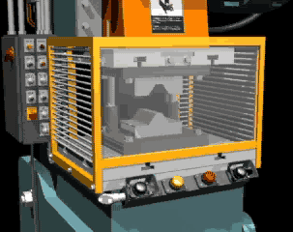
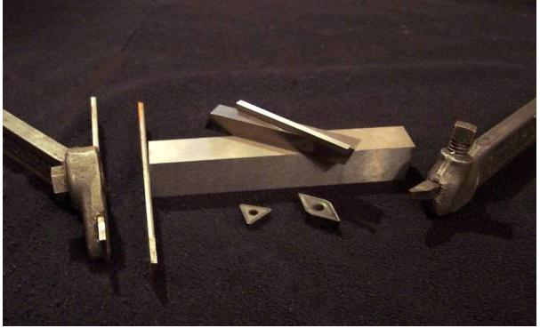
Press with Bending Die & a Cutting Tool

Slide 15
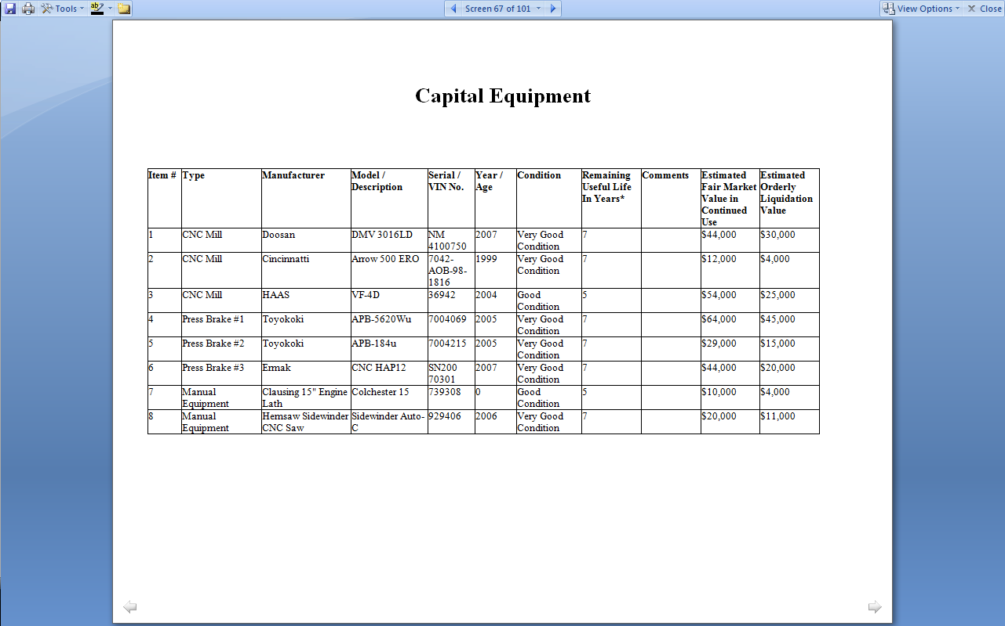
Equipment Detail

Slide 16
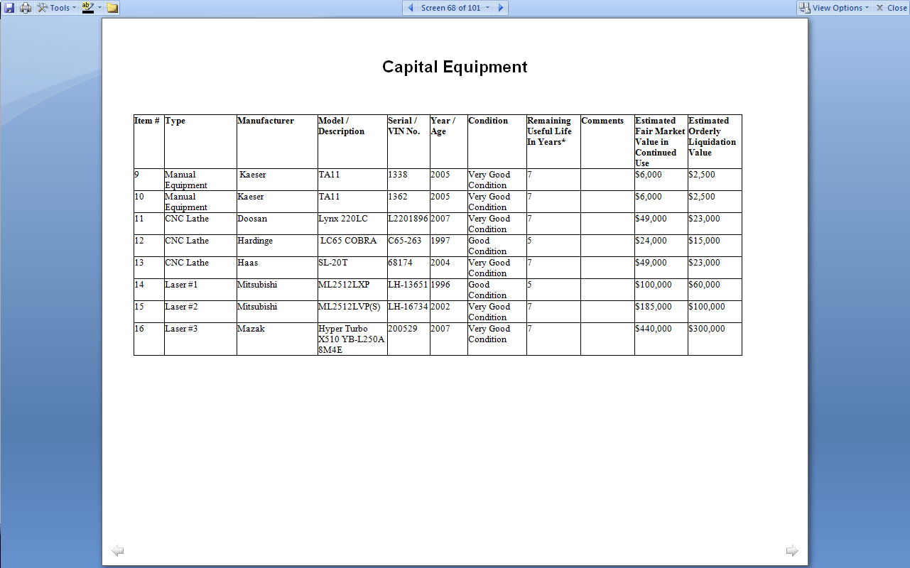
Equipment Detail

Slide 17
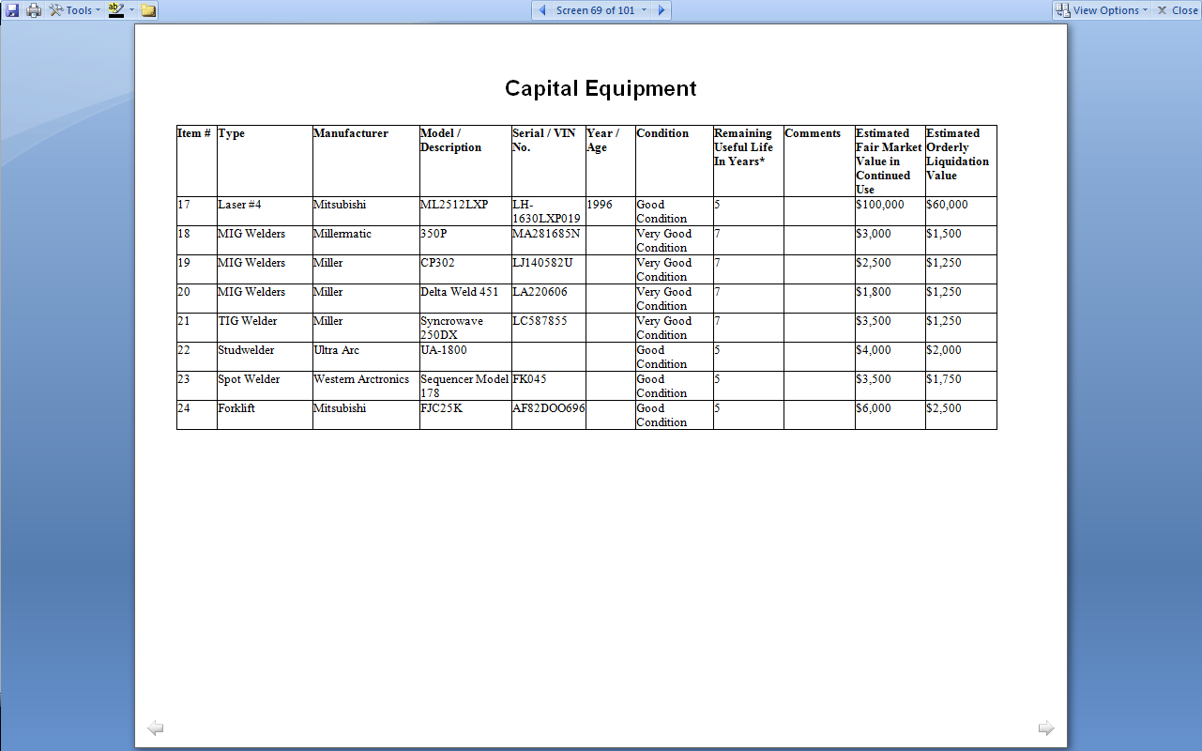
Equipment Detail

Slide 18
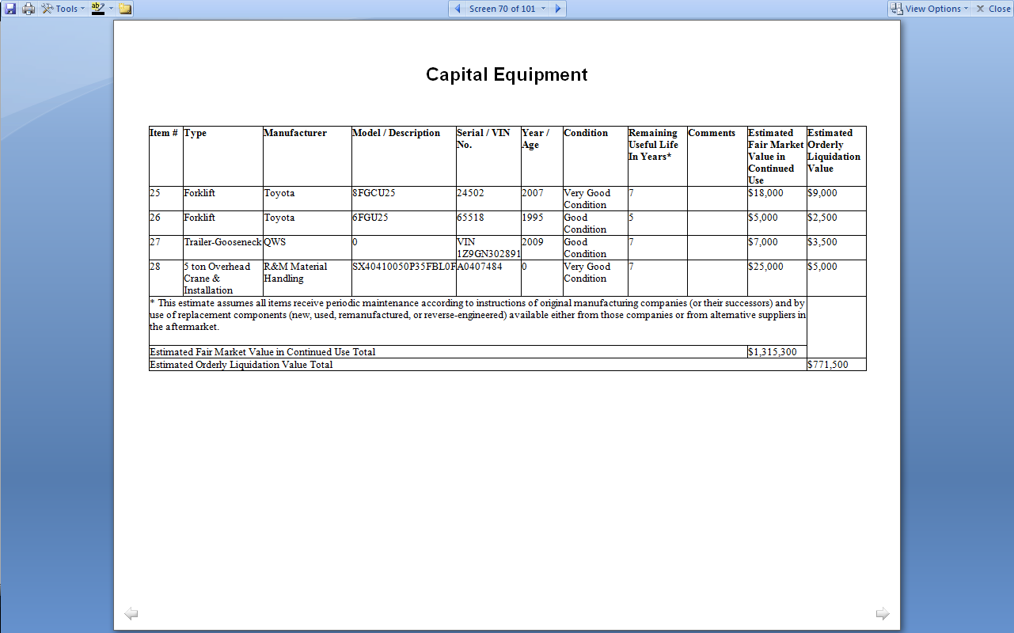
Equipment Detail

Slide 19
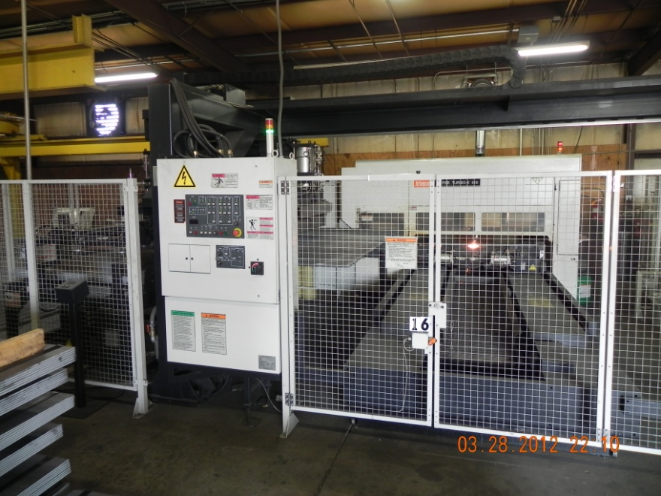
2007 Mazak Hyper Turbo Laser
Historical Cost - $570,000
FMV Per Appraisal - $440,000
Gaston County Tax Value - $467,400
Difference = (6.2%)

Slide 20
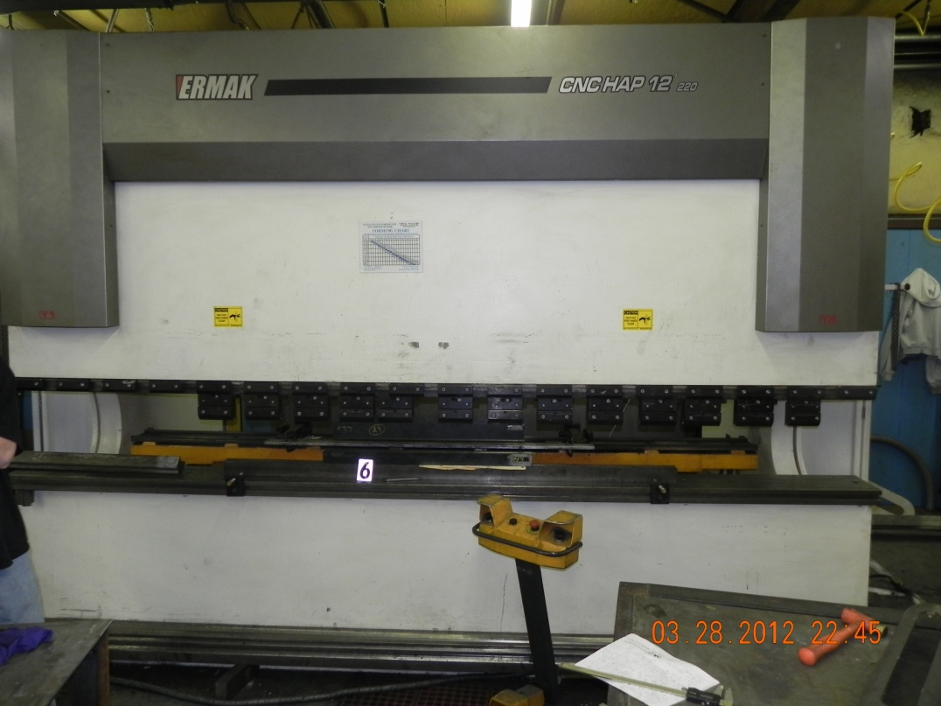
2007 Ermak Press Brake
Historical Cost - $75,000
FMV Per Appraisal - $44,000
Gaston County Tax Value - $47,250
Difference = (7.4%)

Slide 21
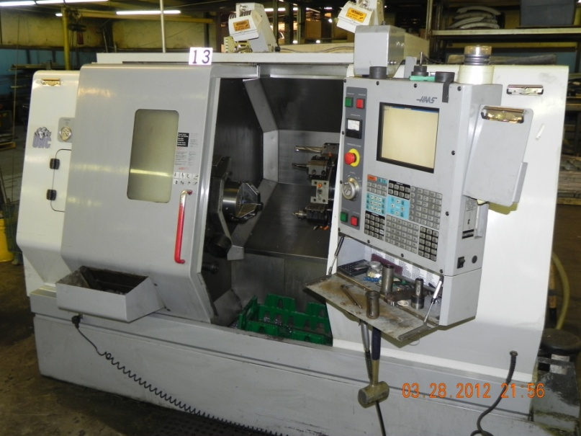
2004 HAAS Lathe VF-4D Milling Center
Historical Cost - $70,095
FMV Per Appraisal - $54,000
Gaston County Tax Value - $17,524
Difference = 68%
3 | CNC Mill | HAAS | VF-4D | 36942 | 2004 | Good Condition | 5 |  | $54,000 | $25,000

Slide 22
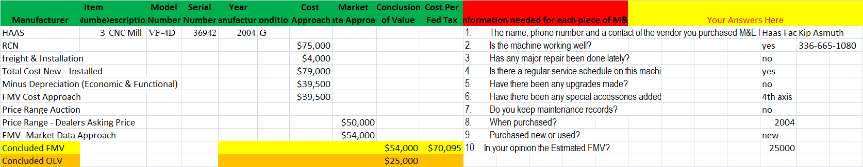
Appraisal Notes HAAS VF-4D

Slide 23
M&E Appraisal Data Collection Form

Slide 24
Appraisal Contacts (Partial List)

Slide 25
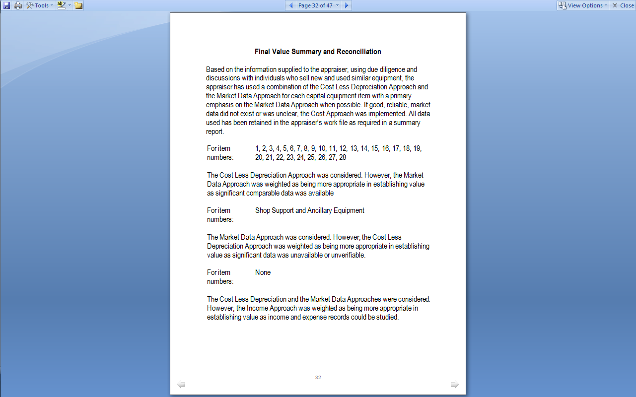
Final Value Summary

Slide 26
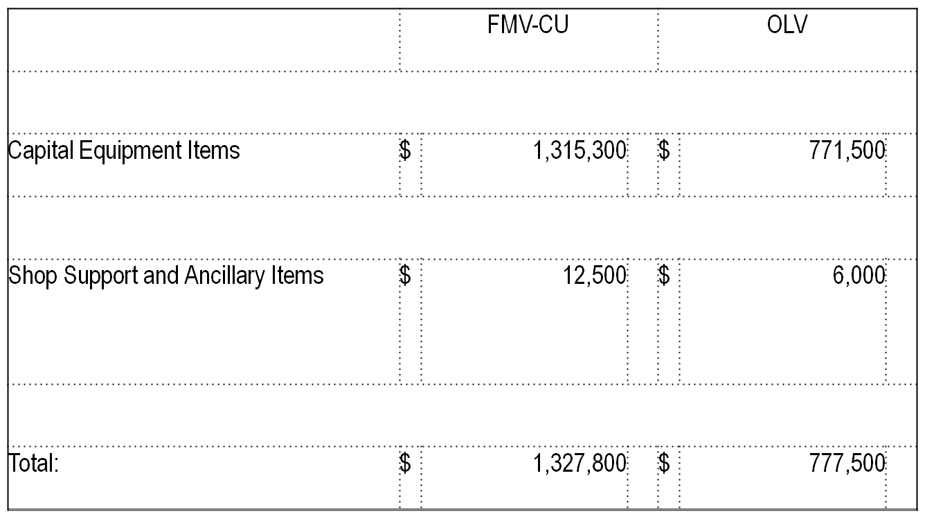
Value Reconciliation

Slide 27
Seventh Inning Stretch

Slide 28
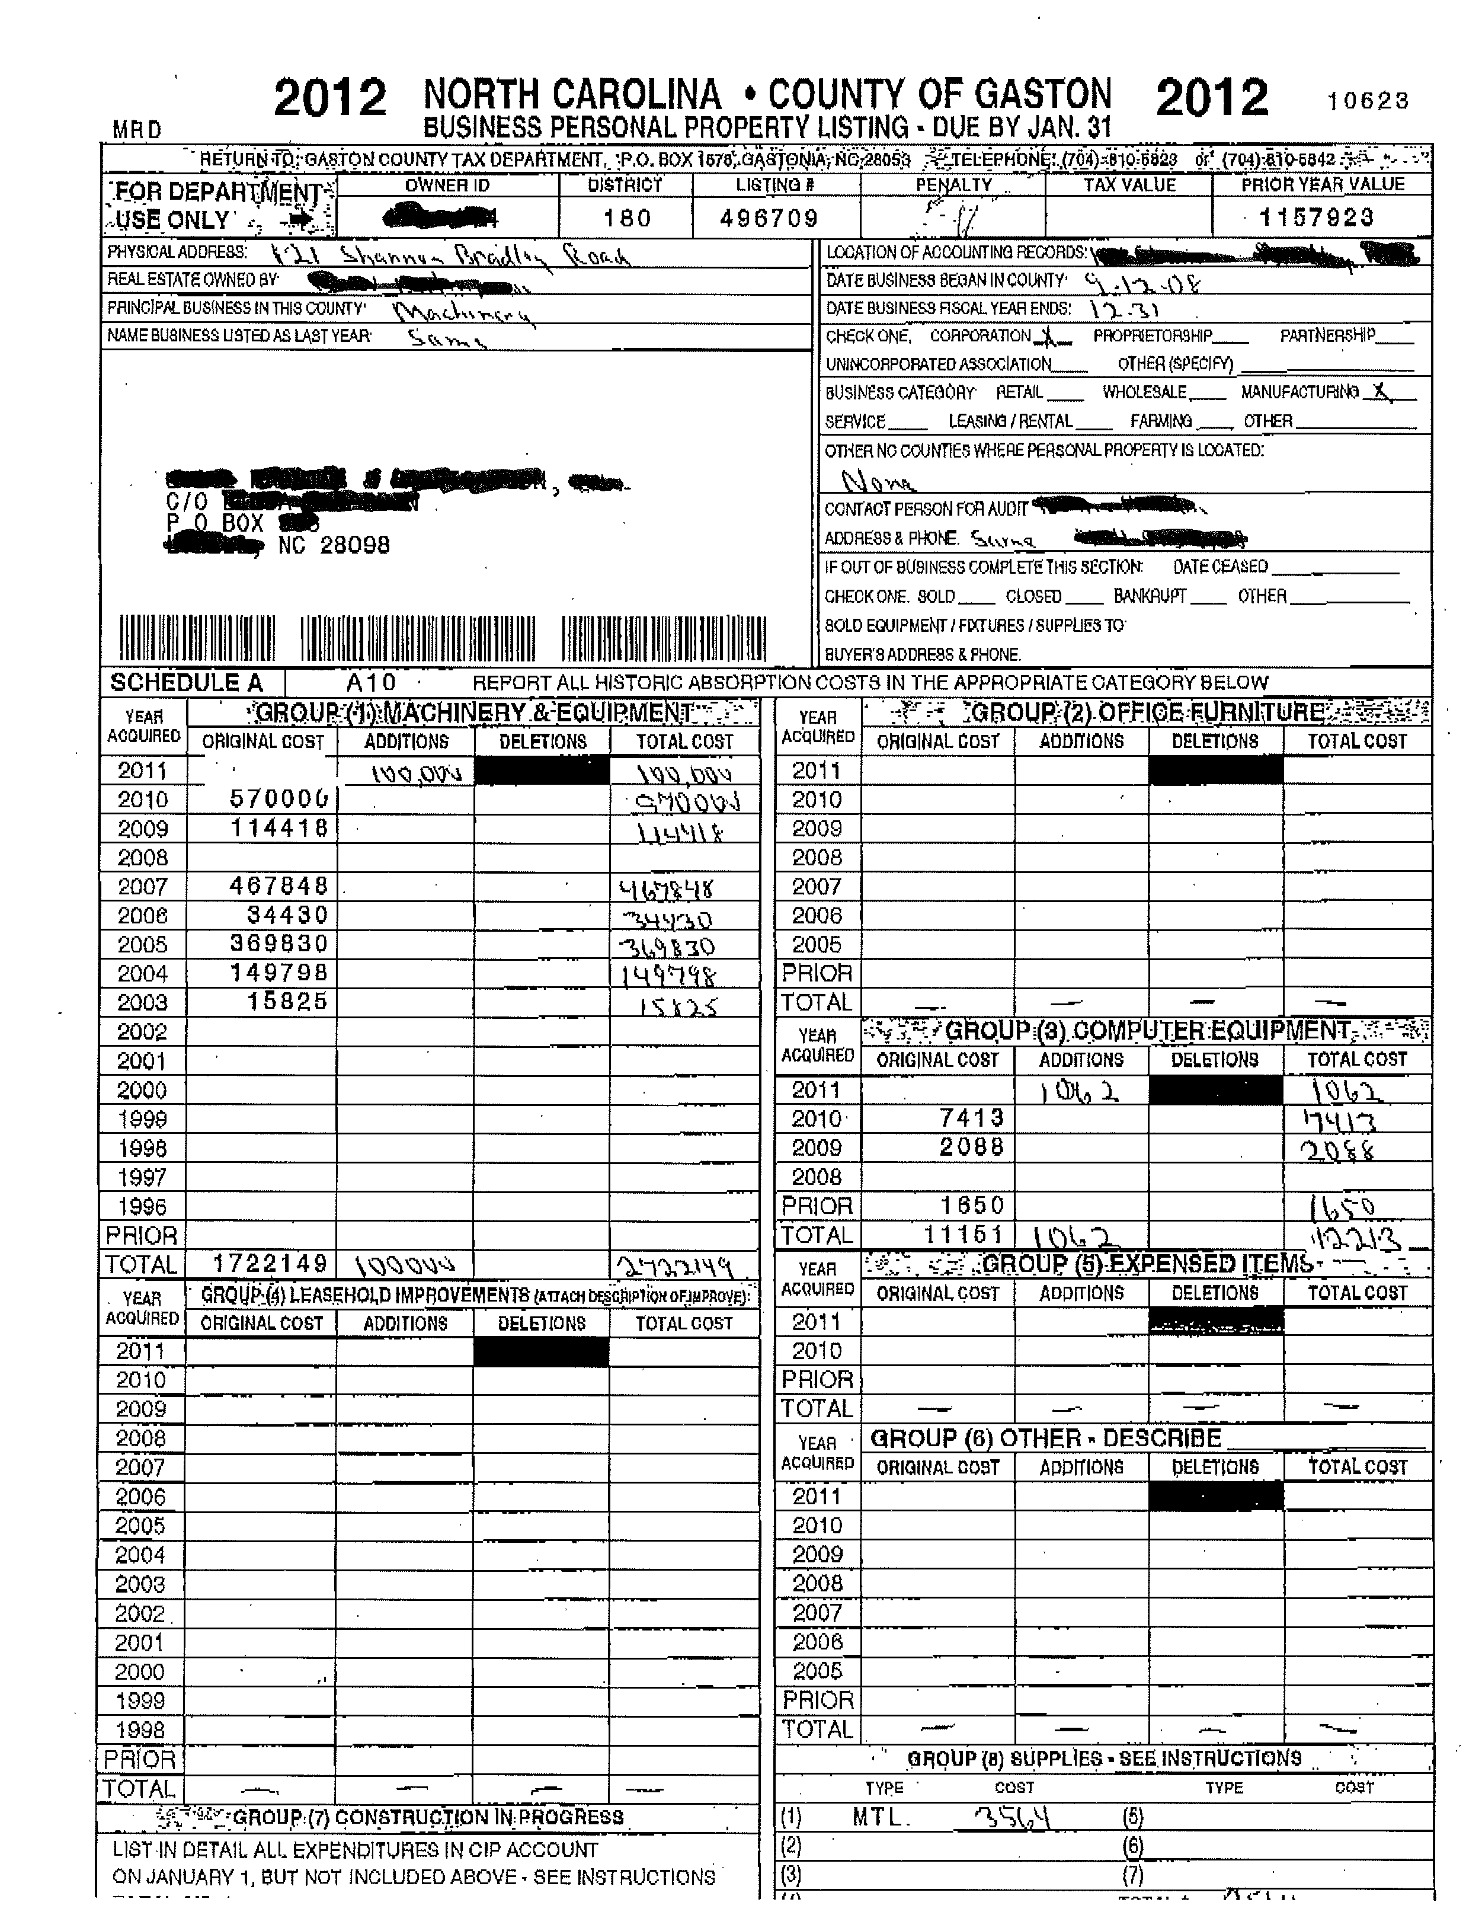

Slide 29
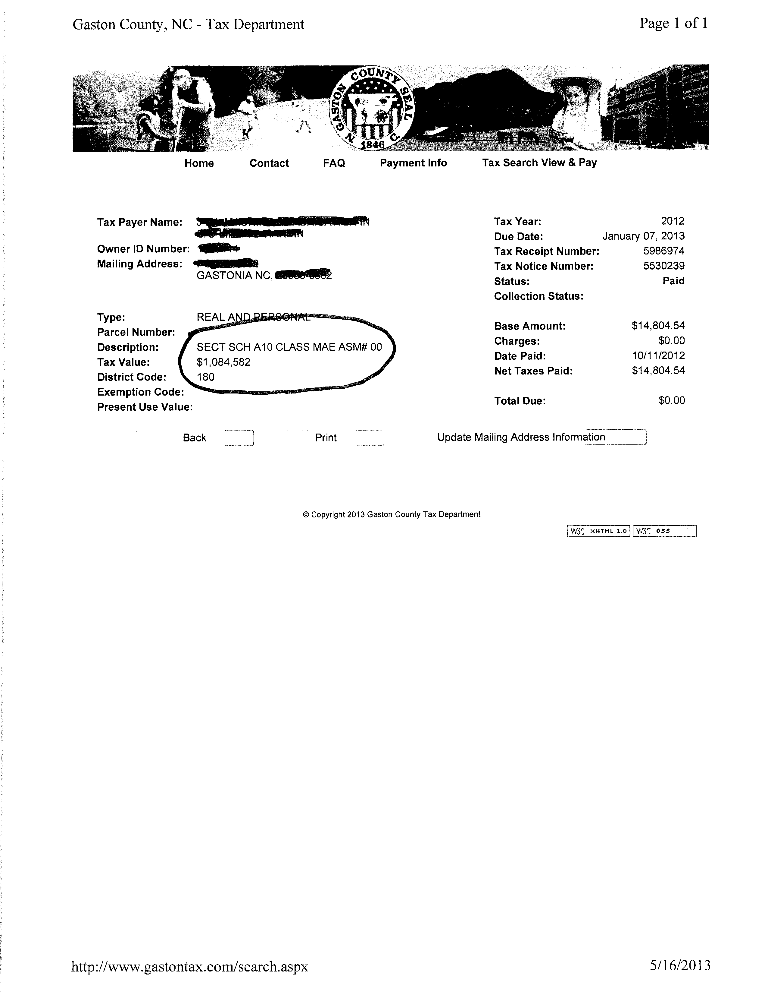

Slide 30
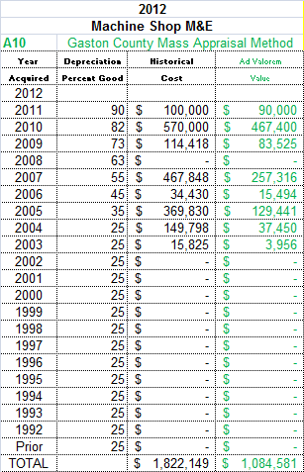
Mass Appraisal Method Trend & Depreciate

Slide 31
Making Heads or Tails out of the M&E Appraisal Compared to the Ad Valorem Appraisal

Slide 32
Nuances Among the Appraisal Method Utilized by the M&E Appraiser vs. the Mass Appraiser
The M&E appraiser often utilizes the market approach
The mass appraiser is prone to exclusively utilize the cost approach
When a cost approach is necessary USPAP SR-7.4 requires the M&E appraiser to calculate the accrued depreciation. The M&E appraiser must estimate the effective age of the property
  Effective age can be greater than, equal to, or less than chronological age
The mass appraisal cost approach utilized in most jurisdictions presume chronological age = effective age.

Slide 33
Economic Obsolescence
The Inutility Method
Inutility formula = | [(Actual Production/Design Capacity)^(scale factor)] X 100
Scale Factor: | Studies indicate cost-capacity factors average .6 to .7
Note: | Design Capacity < Max Capacity. It is based upon a theoretical product mix and often allows for future expansion.

Slide 34
U.S. Capacity Utilization Rates
U.S. average capacity utilization total industry
  1972-2012 = 80.2%
Manufacturing average capacity utilization
  1972-2012 = 78.7%
Source: Board of Governors of the Federal Reserve System
Industrial Production and Capacity Utilization – G.17 Release Date July 16, 2013

Slide 35
Takeaways Obsolescence
If the inutility calculation is utilized to quantify economic obsolescence remember to ask questions:
  Did you Calculate the RCN for the subject M&E?
  How did you calculate the effective age of the M&E?
  Did the market approach corroborate the obsolescence?
    Request copies of comps
The source documents which depict the plant capacity and the plant utilization
Perform your own analysis to determine what are customary utilization rates for the subject Company’s industry
Attempt to find comparables to verify the presence of economic or functional obsolescence

Slide 36
Takeaways M&E appraisal
Caveat Utilitor – M&E appraisal is an unregulated industry
  There are plenty of good M&E appraisers
  Perform some due diligence to ascertain the validity of the M&E appraisal
To corroborate the veracity of an M&E appraisal ask for these items:
  Data collection forms or their equivalent
  Conversation notes and contact information to ascertain the RCN and market approach
  Ask the appraiser for the contact information of the expert who gave him/her the tour at the subject company

Slide 37
Discussion & Questions

Slide 38
The Finish Line!

