Slide 1

Business Valuation: ten things you need to know
By Jim Turner, CPA, CVA, CMEA

Slide 2


Slide 3
Business Valuation: ten things you need to know
Drivers of Business Value - the 411:
  Cash flow – is usually a bigger driver of value than revenue
    EBITDA –
    Seller’s Discretionary Earnings = EBITDA plus owners' remuneration
    Net after tax cash flow
  Quality of earnings
    Diverse customer base equates to less risk for a potential buyer
    Recurring revenue versus one-off sales
    Supplier diversification can effect cash flow quality too
Organized labor force

Slide 4
Business Valuation: ten things you need to know
  Normalizing Adjustments aka Addbacks 101
  Most main street and mid street valuations begin with unaudited tax or book basis financial statements.
    The cash flow must be adjusted to “economic reality” or “as if publicly traded”
    Owners compensation must be examined to determine if it is inadequate or super adequate
    Rent expense paid to a related entity must be reviewed
    Lavish lifestyle expenses need to be adjusted from the income stream
    Salaries paid to inactive family members are adjusted
  Often mistaken for an addback
    Shareholder distributions, draws, dividends
    Cell phone expense

Slide 5
Business Valuation: ten things you need to know
  Rules of Thumb - are they reliable?
  The adage “CPA firms are worth 1 times annual revenue” is often informally used as a “Rule of Thumb”
  Rule of Thumb Source: “Business Reference Guide” (see notes below from the BRG)
    1.0x to 1.25x annual revenues
    2.2x EBITDA
      Most valuable - long-term clients, long-term employees, diverse client base, good systems and record keeping are most valuable.
      Accounting firms in major metro areas, with solid fees, and that are profitable, tend to sell for 1x to 1.35x annual revenue
      Dependent on type of clients; 1040 clients result in lower pricing; monthly and retainer clients results in higher pricing. Audit are preferred by a minority of firms.
Notes:
Tell Todd Greene Story. A CPA contacted me in September because he and partner were discussing buy/sell agreement. He indicated that it is his understanding that CPA firms generally sell for a multiples of 12 months average revenue between 1 and 1.5. Do they sell for 1 until you hit a certain revenue level?

Slide 6
Business Valuation: ten things you need to know
  CPA firm valuation
  CPA firm comparable sales results:
    Identified twenty-four comparable sales in NC, SC, GA, (2015-2020)
    Revenue between $223k - $1.416MM
    Cash Flow was the catalyst for the sales price
Notes:
Tell Todd Greene Story. A CPA contacted me in September because he and partner were discussing buy/sell agreement. He indicated that it is his understanding that CPA firms generally sell for a multiples of 12 months average revenue between 1 and 1.5. Do they sell for 1 until you hit a certain revenue level?

Slide 7
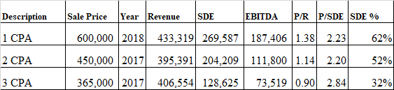
Business Valuation: ten Things you need to know
  CPA Firm Valuation
      %SDE/REVENUE = 62% for the 1.38x
      %SDE/REVENUE = 32% for the .89x

Slide 8
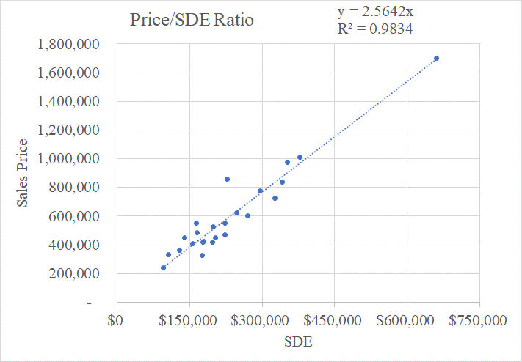
Business Valuation: ten things you need to know
  CPA Firm Valuation

Slide 9
Business Valuation: ten things you need to know
  Calculation engagement versus a Valuation engagement
  The AICPA recognizes two report formats in its Statement on Standards for Valuation Services No.1
    Calculation engagement – the valuator and the client agree on the valuation approaches and methods the valuation analyst will use. A calculation engagement does not include all the procedures required for a valuation engagement.
    Valuation engagement – the valuator is free to apply the valuation approaches and methods he or she deems appropriate in the circumstances.
Notes:
Calculation engagement results in a calculated value. There are 3 approaches to value a business: asset, income, and market. A calculation engagement can be appropriate for buy/sell deliberations, strategic planning, mediation, etc. Example: a software company with very little tangible assets wants to know the value of her business for a potential sell side scenario. The asset approach is likely to be irrelevant. It is agreed the valuator will use the income and market approaches to calculate the value. Valuation engagement results in a conclusion of value report. A conclusion of value is required for the IRS, adversarial litigation matters, 409A, Form 5500 Schedule E

Slide 10
Business Valuation: ten things you need to know
  SBA Business Valuation SOP 50 10 6 effective 10-01-2020
Business Valuation Requirements – Change in ownership (pp.262-264)
  If goodwill > $250k an independent business valuation is required
  If there is a close relationship between the buyer and seller (i.e. family members or existing owners) then a business valuation is required
  Qualified Sources - for Business Valuations (p.534)
  Equity Injection = 10%
Notes:
Business Valuation is the key component to the analysis of any loan application for a change in ownership.

Slide 11
Business Valuation: ten things you need to know
Equitable Distribution Valuation in N.C.
  The trial judge must determine the net value of property. [Conway v. Conway.]
  Marital property is valued as of the date of separation (DOS). [G.S. 50-21(b).]
  Passive appreciation and diminution in the business after the DOS and before the date of distribution is divisible. Divisible unless caused by actions of one spouse.
  There is no single best approach to valuing a professional association or practice [Sharp v. Sharp (quoting Poore v. Poore)]
  IRS Revenue Ruling 59-60 identifies eight factors fundamental in valuing private equity in a business.
  A Nationwide insurance agency which could not be sold still had value to the husband above and beyond a salary or the net worth of the fixed assets. [Hamby v. Hamby]
Notes:
To calculate net value, the trial judge finds the fair market value of an asset and reduces it by the value of any encumbrances on that asset. [Hill v. Hill, 229 N.C. App. 511, 529, 748 S.E.2d 352, 364 (2013) (citations omitted but opinion noted an “abundance of case law”
IRS Revenue Ruling 59-60 [Rev. Rul. 59-60, 1959-1 C.B. 237.] identifies eight factors as fundamental in valuing the stock of a closely held corporation: a. “The nature of the business and the history of the enterprise from its inception;”
b. “The economic outlook in general and the condition and outlook of the specific industry in particular;”
c. “The book value of the stock and the financial condition of the business;”
d. “The earning capacity of the company;”
e. “The dividend-paying capacity;”
f. “Whether or not the enterprise has goodwill or other intangible value;”
g. “Sales of the stock and the size of the block of stock to be valued;” and
h. “The market price of stocks of corporations engaged in the same or a similar line of business having their stocks actively traded in a free and open market, either on an exchange or over-the-counter.” [Rev. Rul. 59-60, 1959-1 C.B. 237, § 4.01.]

Slide 12
Business Valuation: ten things you need to know
The approaches to value and when they are applicable
  Asset Approach – a general way of determining a value indication of a business using one or more methods based on the value of the assets net of liabilities.
    Most appropriate for valuing investment or real estate holding companies
  Market Approach – the idea behind the market approach is that the value of a business can be determined by reference to reasonably comparable guideline companies (“comps”) for which transaction values are known.
  Income Approach – a general way of determining a value indication of a business, using one or more methods that convert anticipated economic benefits into a present single amount.
Notes:
IRS Revenue Ruling 59-60 [Rev. Rul. 59-60, 1959-1 C.B. 237.] identifies eight factors as fundamental in valuing the stock of a closely held corporation: a. “The nature of the business and the history of the enterprise from its inception;”
b. “The economic outlook in general and the condition and outlook of the specific industry in particular;”
c. “The book value of the stock and the financial condition of the business;”
d. “The earning capacity of the company;”
e. “The dividend-paying capacity;”
f. “Whether or not the enterprise has goodwill or other intangible value;”
g. “Sales of the stock and the size of the block of stock to be valued;” and
h. “The market price of stocks of corporations engaged in the same or a similar line of business having their stocks actively traded in a free and open market, either on an exchange or over-the-counter.” [Rev. Rul. 59-60, 1959-1 C.B. 237, § 4.01.]

Slide 13
Business Valuation: 10 things every CPA needs to know
  Of all the intrinsic characteristics related to an equity interest one may be more important than the element of control.
  Advantages of maintaining a control position in a privately held enterprise
    Power to acquire and dispose of business assets
    Power to dictate dividend policy and payments
    Power to revise company organization documents
  Minority ownership interests in privately held businesses may be worth much less than their proportionate share of the overall business value.
Why 51% is 100% better than 49%
Notes:
IRS Revenue Ruling 59-60 [Rev. Rul. 59-60, 1959-1 C.B. 237.] identifies eight factors as fundamental in valuing the stock of a closely held corporation: a. “The nature of the business and the history of the enterprise from its inception;”
b. “The economic outlook in general and the condition and outlook of the specific industry in particular;”
c. “The book value of the stock and the financial condition of the business;”
d. “The earning capacity of the company;”
e. “The dividend-paying capacity;”
f. “Whether or not the enterprise has goodwill or other intangible value;”
g. “Sales of the stock and the size of the block of stock to be valued;” and
h. “The market price of stocks of corporations engaged in the same or a similar line of business having their stocks actively traded in a free and open market, either on an exchange or over-the-counter.” [Rev. Rul. 59-60, 1959-1 C.B. 237, § 4.01.]

Slide 14
Business Valuation: 10 things every CPA needs to know
Why 51% is 100% better than 49%
  Dividends/Distributions have a significant impact on the discount for control
Notes:
A review was conducted of the data published by Partnership Profiles, Inc. (PPI), a company that provides financial and transaction data on privately held limited partnerships and from the Partnership Profiles Minority Interest Discount Database. The Partnership Profiles surveys have perennially found that cash distributions and debt levels typically have the most impact on the pricing of non-controlling ownership interests in real estate business entities. The table below published by Partnership Profiles depicts the difference in the discount for lack of control [and marketability] between partnerships that distribute cash (17%-19%) versus those that don’t pay distributions (36%).
Partnership Profiles, Inc., 2015, pp.6-7

Slide 15
Business Valuation: 10 things every CPA needs to know
Why 51% is 100% better than 49%
Notes:
Value of 100% interest $1,770,000 pro rata value of 25% interest $442,500
DLOC = 15%
DLOM = 24%
Total Discounts = 35.4%
IRR with no distributions 3.18%
IRR with distributions at proportionate value of $442,500 = 9.04%

Slide 16
Business Valuation: 10 things every CPA needs to know
Why 51% is 100% better than 49%
  Dividends/Distributions have a significant impact on the discount for control – IRR/Calculation w/ distributions of 11.38% of FMV
Notes:
Value of 100% interest $1,770,000 pro rata value of 25% interest $442,500
DLOC = 15%
DLOM = 24%
Total Discounts = 35.4%
IRR with no distributions 3.18%
IRR with distributions at proportionate value of $442,500 = 9.04%

Slide 17
Business Valuation: 10 things every CPA needs to know
Why 51% is 100% better than 49%
  Dividends/Distributions have a significant impact on the discount for control – No distribution IRR calculation
Notes:
Value of 100% interest $1,770,000 pro rata value of 25% interest $442,500
DLOC = 15%
DLOM = 24%
Total Discounts = 35.4%
IRR with no distributions 3.18%
IRR with distributions at proportionate value of $442,500 = 9.04%

Slide 18
Questions

Slide 19
A few Takeaways
While revenue is important “Cash Flow” is the key driver of value for a privately held business. Rules of thumb based upon revenue are still ultimately driven by cash flow.
A calculated value is an AICPA recognized reporting format that is more limited in scope than a conclusion of value, but it is often a cost-effective way to determine the value of a privately held business especially for internal management or buy/sell deliberations
The element of control to an equity interest is arguably the most important intrinsic characteristic.

Slide 20

Contact Information
Jim Turner, CPA, CVA, CMEA
Turner Business Appraisers, Inc.
704.821.0667
Jim.Turner@turnerbusiness.com
www.turnerbusiness.com
PO Box 1857
Matthews, NC 28106

Slide 21


